Slide 1
Rubber Ducky Parking
Implementing a Parking App with Django Rest-API and React.js
Group 6
Peyton Kiel
Bryson Meiling
Andrew Rasmussen
Brandon Garrett

Slide 2
Overview
This is an implementation of a ‘AirBnB’ like app that allows people to rent parking spots from a convenient website, bypassing the hassle of looking for parking spots during events, works, shopping, etc.
The front end uses a React.js development web server and uses react.js to track the state of the website. Stylizing mainly uses bootstrap and custom stylings.
The back end uses Django REST Framework that communicates with the react.js frontend using standard CRUD API calls. This sped up api url route development and brought many built in features that weren’t available in just Django.

Slide 3
Major Design Decisions
React.js - This sped up the development of the front end. Not only did it allow us to make more interactive forms, modal windows, and overall better experience, but also it is in high demand for the job market. We wanted to improve our own skills and makes ourselves more marketable.
Django REST Framework - We were all comfortable with Django, and this was a natural extension of this. This library adds function-based views and better authentication models for our different classes of users (base, host, attendant)

Slide 4
Agile Development Process
We used Github extensively to track code, and issues, Kanban boards. By uses these tools, we were able to pivot course if one of our branches was not working well with previously written code.
We actively were going through development, implementation, testing, and revision mini-processes that helped get us to the final product.
By using the agile process, we would focus on creating pages, routes, and content and then worrying about how to connect them. It allowed for faster development and not as much worry of messing up code because we had Git and Github.

Slide 5
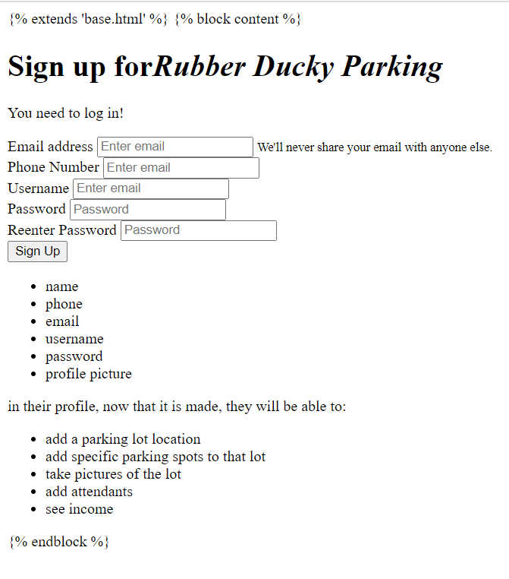
Requirement #1 - Easy Sign up
Req 4.1.2: The sign up process MUST be user friendly, check for data input errors, and self explanatory.
This first version was worked but didn’t have the capability of front end type checking and sent everything back to the django frame for everything. It was static and wasn’t pretty

Slide 6
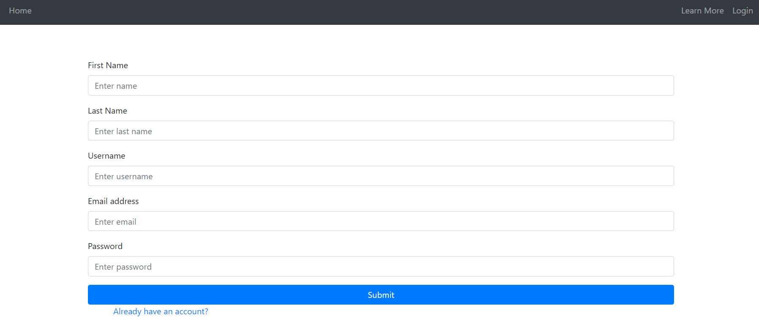
Requirement #1 - Cont.
FURPS: The final version is much more user friendly, checks the data before sending it to the api, and can handle more interaction. This means that when a user hits enter while in a box, it will check to see if everything is ready to send or will give a notification. It's more functional, more preformant (not sending everything to api for checking), and more secure from malicious data input.

Slide 7
Requirement #2 - Token Authentication
Req 3.2.1 - The System SHOULD create a Token to authenticate users. This is a Must-Have requirement.
FURPS: Users must be signed into different tiers of usability and the front end renders out the page differently depending if the user is normal, a host, or attendant. Using a generated token from Django would allow for a better user support and reliability since the user would know what pages to expect. The Functionality and Secure of O Token authentication is extremely important also.

Slide 8
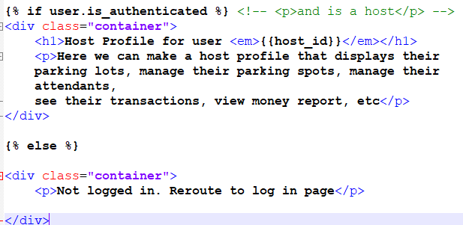
Requirement #2 - Cont.
First, we only had capability to know if a user was authenticated or not. This screenshot shows the django template where it asks if user.is_authenticated. This process is okay, but now as flexible as react.js and its JSX language.

Slide 9
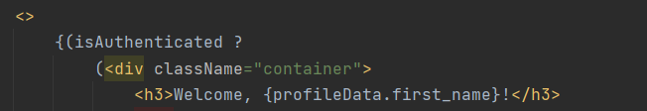

Requirement #2 - Cont.
With JSX in react.js, we were able to have state variables that cause a page re-render when they are changed. Depending on their state, we can render different parts of the page on the clients browser.

Slide 10
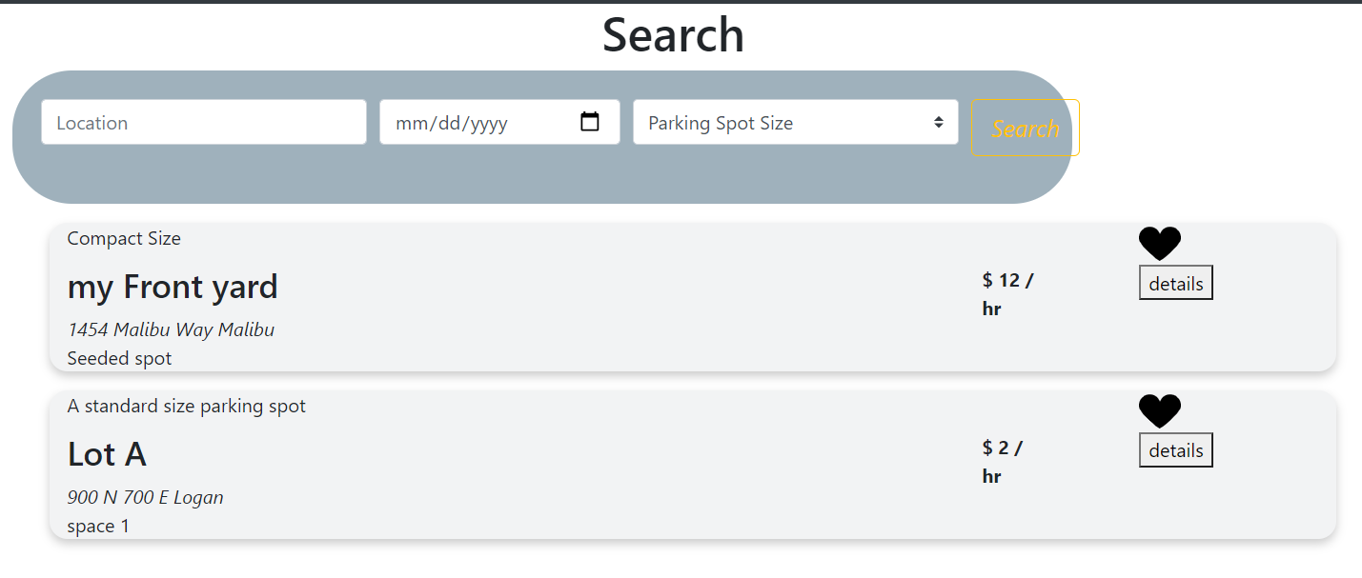
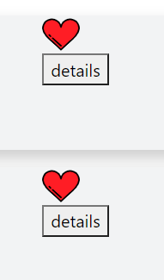
Requirement #3 - Fav Parking Spots
Req. 1.3.1 : The user COULD be allowed to ’fav’ parking spots which would show a red heart when searching for parking spots.
FURPS: This adds functionally to the user since they can keep track of spots they’ve looked at. This adds greatly to the usability and User Experience of the website. There is not a log of support that needs to be changed in order to use this so it's not going to cause future problems.

Slide 11
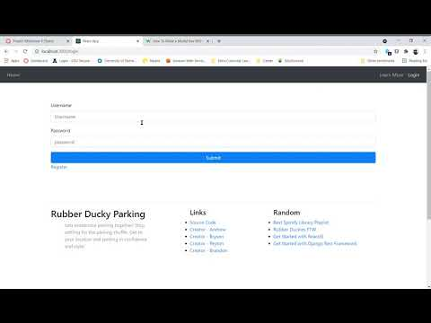
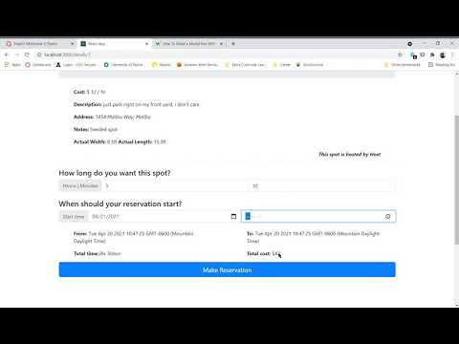
Use Case #1 - Creating account, making res.
Creating an Account Making a Reservation

Slide 12
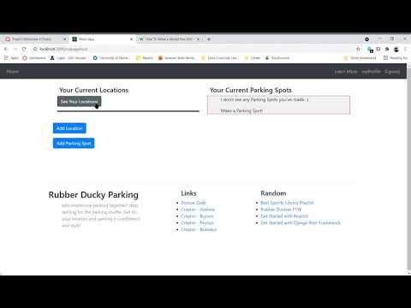
Use Case #2 - Becoming host
Becoming a Host

Slide 13
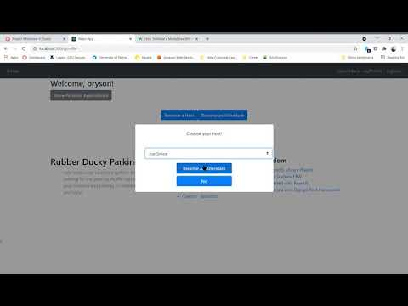
Use Case #3 - Becoming Attendant

Slide 14
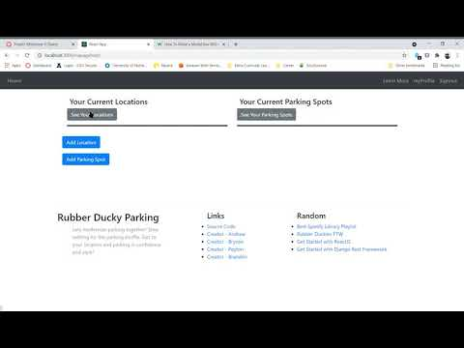
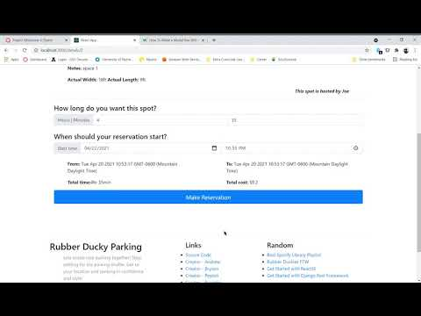
Use Case #4 - Using Host/Attendant Dashboards
Host Dashboard Attendant Dashboard

Slide 15
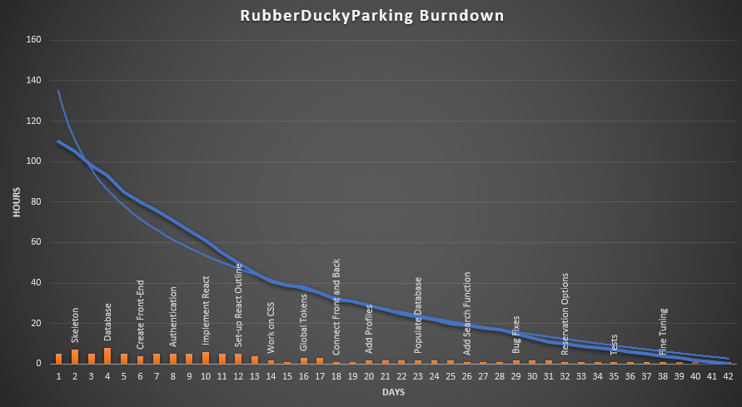
Burn Down Chart

Slide 16
Timeline (Milestone #4)
14th - Milestone #3 Due
15th - Pull together dashboards and modal confirmation windows into profile
17th - Complete Testing for the main use case routes
19th - Finish code and attendant routes
20th - Complete Slideshow and Documents
21st - Milestone #4 Due

Slide 17
Resources
Bootstrap Beginner Crash Course. YouTube. (2017). YouTube. https://www.youtube.com/watch?v=5GcQtLDGXy8.
Christie, T. (2021, April 1). Django REST Framework. Home - Django REST framework. https://www.django-rest-framework.org/.
Django Rest Framework Authentication Crash Course. (2019). YouTube. https://youtu.be/ddB83a4jKSY.
Facebook. (n.d.). React – A JavaScript library for building user interfaces. – A JavaScript library for building user interfaces. https://reactjs.org/.
Mark Otto, J. T. (n.d.). Bootstrap. Bootstrap · The most popular HTML, CSS, and JS library in the world. https://getbootstrap.com/.
React Js Crash Course 2021. YouTube. (2021). YouTube. https://www.youtube.com/watch?v=w7ejDZ8SWv8.

Slide 18
Q & A

